Slide 1



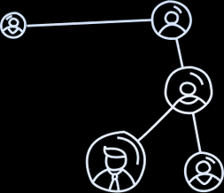
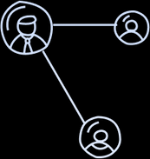




Kharagpur Blockchain Society
IIT Kharagpur
East-India
Blockchain Summit 2.O
East-India’s
Largest
Blockchain hackathon
Swipe

Slide 2
East-India Blockchain Summit 2.0
Team Name: Prime Squad
Team Leader Name: Sanjai prasath M
Team Members Name:
Sachin R
Suriya S
3. Veerabharathi V
Problem Statement:
Government bonds are considered safe investments, but access for retail investors is limited due to high minimum investment sizes, complex onboarding, and lack of liquidity. Young investors and students are often excluded from these instruments.
Swipe

Slide 3

East-India Blockchain Summit 2.0
proposed solution
We propose a blockchain-based platform that tokenizes government bonds into small, fractional units. Each government bond is divided into digital tokens that represent partial ownership, allowing users to invest with very small amounts. These tokens can be purchased, held, and redeemed using stablecoins through smart contracts. The platform ensures transparent ownership tracking, automated yield distribution, and easy access for students and young investors.
Swipe

Slide 4
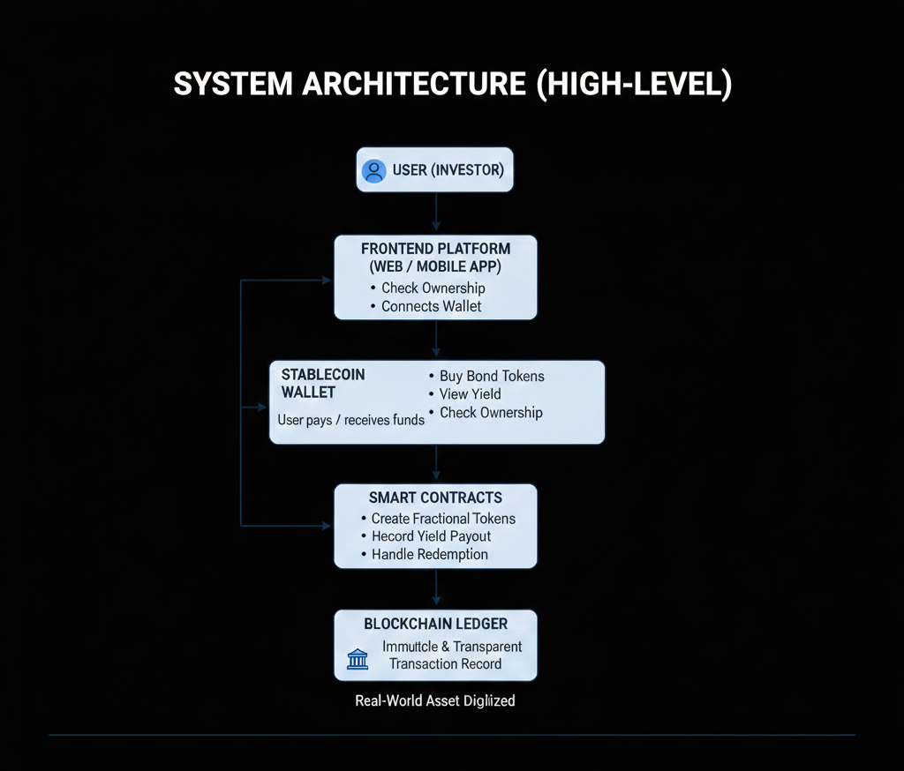
East-India Blockchain Summit 2.0
Architecture diagram
Architecture Explanation
The system consists of a user-facing platform connected to blockchain smart contracts. Users interact with the platform through a web interface to buy fractional government bond tokens using stablecoins. Smart contracts manage token creation, ownership tracking, interest distribution, and redemption. All transactions are recorded on the blockchain, ensuring transparency, security, and immutability without relying on centralized intermediaries.
Component Interaction
Users access the platform through a web application
Stablecoins are used for payment and settlement
Smart contracts handle bond token logic automatically
Blockchain stores ownership and transaction records
Tokenized government bonds represent real-world assets digitally
Swipe

Slide 5
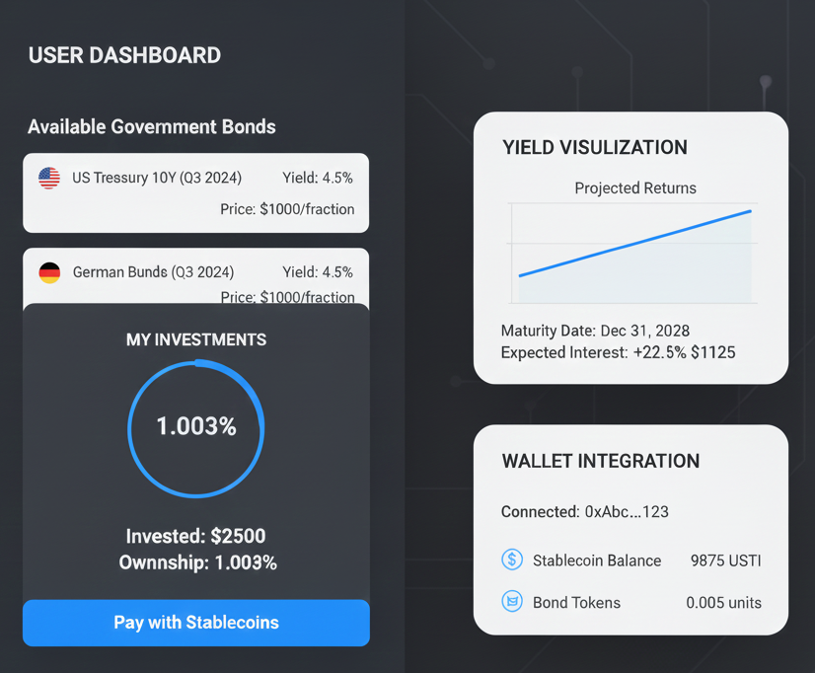
East-India Blockchain Summit 2.0
software prototype
Prototype Overview
The proposed software prototype is a web-based application that allows users to access tokenized government bonds through a simple and user-friendly interface. The platform demonstrates how users can purchase fractional bond tokens using stablecoins, view their investment details, track yields, and redeem tokens at maturity.
Key Screens in the Prototype
User Dashboard
View available government bonds
See invested amount and ownership details
Bond Purchase Screen
Select bond
Choose fractional amount
Pay using stablecoins
Yield Visualization
Displays expected interest
Shows maturity date and total returns
Wallet Integration
Connects user wallet
Displays token balance
Swipe

Slide 6
East-India Blockchain Summit 2.0
usp & business approach
Our USP
Enables fractional ownership of government bonds for students and small investors
Uses blockchain to ensure transparent and tamper-proof ownership records
Automated yield distribution through smart contracts
Stablecoin-based settlement for fast and easy transactions
Combines safe investment with digital accessibility
Business Approach
The platform follows a digital-first and user-centric approach to make government bond investments accessible to a wider audience. By enabling fractional ownership through blockchain technology, the system lowers the entry barrier for students and small investors. Revenue is generated through minimal transaction and service fees, while maintaining affordability and transparency. The platform is designed to scale across different bond types and expand into other real-world assets in the future.
Swipe

Slide 7
East-India Blockchain Summit 2.0
research and references
Government Bonds & Retail Access
Reserve Bank of India – Official Website Information on government securities, auctions, and RBI operations: https://www.rbi.org.in/ ETBFSI.com
RBI Retail Direct – Government Securities Portal Enables retail investors to invest directly in government bonds (official portal): https://rbiretaildirect.org.in/ The Economic Times
RBI Retail Direct Explained – Detailed Guide How individuals can invest in government bonds (Official financial explanation): https://www.business-standard.com/finance/personal-finance/rbi-retail-direct-explained-how-to-invest-in-government-bonds-online-125102200986_1.html Business Standard
Blockchain & Tokenization (Real-World Assets)
Hedera – Real-World Asset Tokenization Official blockchain info about asset tokenization into digital tokens: https://hedera.com/use-cases/real-world-asset-tokenization Hedera
Ethereum Official Documentation Smart contracts and token standards used for tokenization: https://ethereum.org/en/developers/docs/ Hedera
Swipe

Slide 8
East-India Blockchain Summit 2.0
Thank you for your time and consideration
We look forward to your feedback and the opportunity to take this idea forward
“By combining the safety of government bonds with the transparency of blockchain, we aim to make secure investments accessible to everyone.”
Swipe

